Slide 1
HUMAN RESOURCE
MANAGEMENT
RECRUITMENT
AND
SELECTION

Slide 2
HUMAN RESOURCE
MANAGEMENT
BUSINESS OBJECTIVES
HR PLANNING
JOB ANALYSIS
JOB DESCRIPTION
JOB SPECIFICATION
RECRUITMENT

Slide 3

RECRUITMENT
The Process of generating a pool of qualified candidates for a particular job.
OR
The Process of discovering potential candidates.

Slide 4
RECRUITMENT GOALS
1
Attract the Qualified Applicants.
2
Encourage Unqualified Applicants to self-select themselves out.

Slide 5

RECRUITMENT IS A TWO
WAY STREET
Organization is Looking for a Qualified Applicants
Applicants are Looking for the Potential Emplacement Opportunities
RECRUITMENT

Slide 6
RECRUITMENT PROCESS
ORGANIZATION
CANDIDATE
Vacant or New position occurs
Receive Education and choose Occupation
Generate candidate pool via internal or external recruitment methods
Acquire Employment Experience
Evaluate Candidates via Selection process
Search for Job Openings
Impress Candidates
Apply for jobs
Make Offer
Impress Company during Selection process
Evaluate Jobs and Companies
Accept or Reject Job Offers

Slide 7
STRATEGIC RECRUITING
DECISIONS
HR PLANNING DECISIONS
How Many Employees Needed
When Needed
Special Qualifications
STRATEGIC RECRUITING DECISIONS
Where to Recruit: Internal/External
Who to Recruit: Flexible Staffing
Options
Nature of Job Requirements
DECISIONS ON RECRUITING
SOURCES/METHODS
Advertising Choices
Recruiting Activities

Slide 8
STRATEGIC RECRUITING
DECISIONS
FLEXIBLE STAFFING | DESCRIPTIONS
1. REGULAR EMPLOYMENT | Regular employment consists of continuous, predictable, and scheduled employment of six months' duration or longer. Regular employment may be full time or part time.
2. FULL-TIME OR PART-TIME | Full-time employment consists of a regular schedule of 37.5 hours per week. Part-time employment consists of a regular schedule of less than 37.5 hours per week.
3. INDEPENDENT CONTRACTORS | Perform specific services on a contract basis used in a number of areas, including building maintenance, security, and advertising/public relations.
4. PROFESSIONAL EMPLOYER ORGANIZATIONS AND EMPLOYEE LEASING | An employer signs an agreement with an employee leasing company, after which the existing staff is hired by the leasing firm and leased back to the company. For a fee, a small business owner turns his or her staff over to the leasing company, which then writes the paychecks, pays the taxes, prepares and implements HR policies, and keeps all the required records.

Slide 9
STRATEGIC RECRUITING
DECISIONS Cont . . .
5. TEMPORARY WORKERS | This is based on “try before you buy” approach . Employers who use temporary employees can hire their own temporary staff or use agencies supplying temporary workers. Such firms supply workers on a rate-per-day or per-week basis.
6. SEASONAL EMPLOYEES | Seasonal employees are hired to work on a part-time basis by companies that need extra help during a particular season, typically the Ramadan season or crops harvesting.

Slide 10


SOURCES OF RECRUITMENT
SOURCES OF
RECRUITMENT
INTERNAL
SOURCES
EXTERNAL
SOURCES

Slide 11
SOURCES OF RECRUITMENT
Job Posting &
Bidding
Promotions and
Transfers
INTERNAL
SOURCES
Employee
Referrals
Re-recruiting former Employees & Applicants
Internal Recruiting
Data base

Slide 12
SOURCES OF RECRUITMENT Cont . . .
Schools Colleges &
Universities
EXTERNAL
SOURCES
Labor
Unions
Media Sources
Employment Agencies

Slide 13
RECRUITING EVALUATION Cont . . .
Using Yield Ratios to Determine Needed Applicants:
300 Applicants
Initial Contacts/Final Interview
(Yield ratio = 3:1)
100 Final Interviews
Final Interview/Offers
(Yield ratio = 2:1)
50 Offers
Offers/Hires
(Yield ratio = 2:1)
25 Hires

Slide 14
BUSINESS OBJECTIVES
HR PLANNING
JOB ANALYSIS
JOB DESCRIPTION
JOB SPECIFICATION
RECRUITMENT
SELECTION

Slide 15
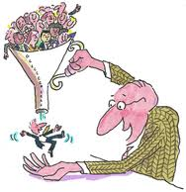

SELECTION
1
The Process of making a “Hire” or “No Hire” decision regarding each applicant for a job.
2
Selection is the process of choosing qualified individuals who are available to fill the positions in organization.
Or

Slide 16
BASIC SELECTION
CRITERIA
Formal Education
BASIC SELECTION
CRITERIA
Experience and Past Performance
Physical Characteristics
Personality Characteristics

Slide 17
SELECTION PROCESS
Initial screening
Fail to meet minimum qualification
Passed
Failed to complete job application or failed job specification
Completed application
Passed
Employment test
Failed Test
Passed
Passed
Conditional job offer
Comprehensive interview
Failed to impress interviewer and / meet job expectations
Background Examination if required
Problem encountered
Reject Applicant
Passed
Medical/physical examination if required (conditional job offer
Unfit to do essential elements of job
Able to perform essential elements of job
Permanent job offer

Slide 18
SELECTION METHODS
The Three most Common Methods used are:
1. Testing
2. Gathering Information
3. Interviewing

Slide 19

SELECTION METHODS Cont . . .
1. TESTING
Tests measure knowledge, skill, and ability, as well as other characteristics, such as personality traits.
TESTING TYPES
Cognitive Ability Test
Personality Test
Physical Ability Test
Integrity Test
Drug Test
Work Sample Testing

Slide 20
SELECTION METHODS Cont . . .
1. Cognitive Ability Testing
2. Physical Ability Testing
It measures the learning, understanding, and ability to solve problems. e.g. Intelligence Tests.
It assesses muscular strength, cardiovascular endurance, and coordination.
TESTING
TYPES
3. Personality Testing
It measures the patterns of thought, emotion, and behavior. e.g. Myers Briggs

Slide 21
SELECTION METHODS Cont . . .
4. Integrity Testing
6. Drug Testing
It is designed to assess the likelihood that applicants will be dishonest or engage in illegal activity.
Normally requires applicants to provide required sample that is tested for illegal substances.
TESTING
TYPES
5. Work Sample Testing
Measures performance on some element of the job.

Slide 22
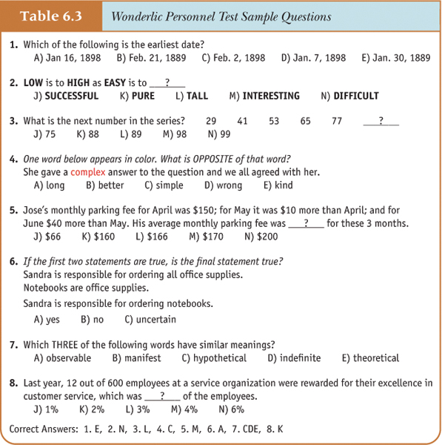
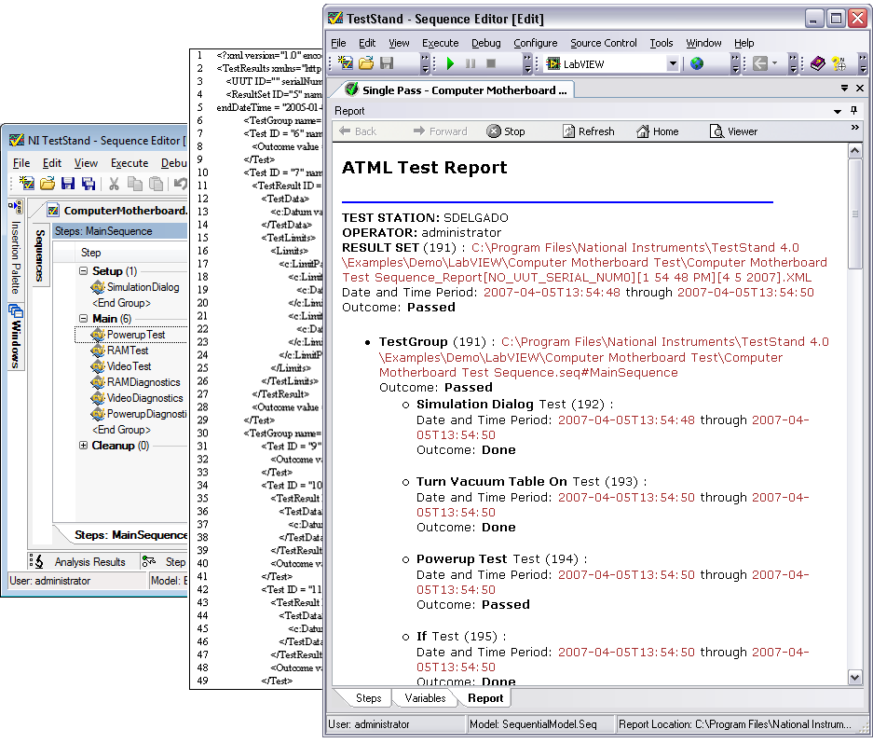
SELECTION METHODS Cont . . .
TEST
SAMPLE

Slide 23

SELECTION METHODS Cont . . .
2. INFORMATION GATHERING:
Common methods for gathering information include application forms and résumés, biographical data, and reference checking.

Slide 24
SELECTION METHODS Cont . . .
Generally ask for information such as address and phone number, education, work experience, and special training.
At the professional-level, similar information is generally presented in résumés.
Application Forms and Résumés
Biographical
Data
Historical events that have shaped a person’s behavior and identity.
Involves contacting an applicant’s previous employers, teachers, or friends to learn more about the applicant Issues with reference checking
Reference Checking

Slide 25

SELECTION METHODS Cont . . .
3. INTERVIEWS:
The interview is the most frequently used selection method.
Interviewing occurs when applicants respond to questions posed by a manager or some other organizational representative (interviewer).
Typical areas in which questions are posed include education, experience, knowledge of job procedures, mental ability, personality, communication ability, social skills.

Slide 26
SELECTION METHODS Cont . . .
Situational Interview
1. Structured Interviews
Behavioral Interview
Types of Interviews
2. Unstructured Interviews

Slide 27
SELECTION METHODS Cont . . .
1. Structured
Interviews
2. Unstructured
Interviews
Uses a list of predetermined questions. All applicants are asked the same set questions. There are two types of structured interviews.
Interviews-open ended questions are used such as “Tell me about yourself”
SITUATIONAL INTERVIEW
In which the interviewer asks questions about what the applicant would do in a hypothetical situation
BEHAVIORAL INTERVIEW
In which the questions focus on the applicant’s behavior in past situations.
This allows the interviewer to probe and pose different sets of questions to different applicants.

Slide 28
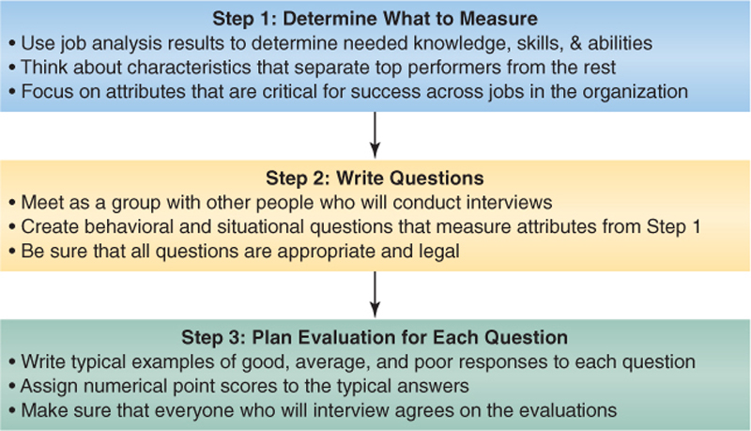
SELECTION METHODS Cont . . .
CREATING STRUCTURED INTERVIEW QUESTIONS

Slide 29
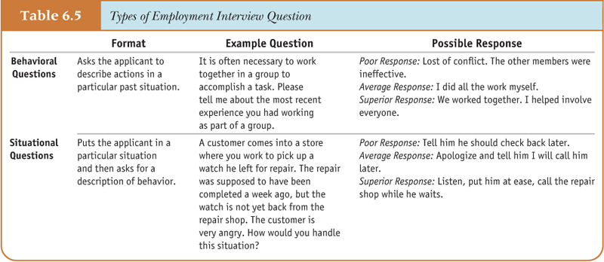
SELECTION METHODS Cont . . .
INTERVIEW QUESTION

Slide 30
Attract the Qualified Applicants
CHAPTER : 3
Internal Recruitment Sources
Organizational Data Base
Job Posting
Promotions & Transfers
Recruitment
Goals
Employee Focused
Employee Referrals
Re-recruit Former
Employee
Encourage Unqualified Applicants to self select themselves out
External Recruitment Sources
Colleges & Universities
Professional Organizations
Employee Leasing
Organization is looking for a Qualified Applicants
Unsolicited Applications
Media Sources & Job Fairs
Placement Agencies
Recruitment
(2 way process)
RECRUITMENT
Applicants are also looking for the Opportunities
Internet Recruitment Sources
Job Boards
Employer Web Sites
Budgeting
Regular vs. Flexible
Recruiting Evaluation
Quantity of Applicants
Quality of Applicants
Yield Ratio
Strategic Recruitment Decisions
Image of the Company
Attractiveness of Job
Organizational vs. Outsourcing
Internal vs. External
Constraints on Recruiting
Recruitment
&
Selection
Internal Org. Policy
Recruitment Cost
Formal Education
Experience and Past Performance
Basic Selection Criteria
Cognitive Ability Test
Personality Test
Physical Ability Test
Physical Characteristics
KSA
Testing
Integrity Test
Drug Test
Work Sample Test
Personality Characteristics
Other Characteristics
Application Forms
Resumes
Biographical Data
Initial Screening
Completed Application
Employment Test
Comprehensive Interview
Conditional Job Offer
Background Examination
Medical or Physical Examination
Permanent Job Offer
Information Gathering
SELECTION
Reference Checking
Defamation of Character
Negligent Hiring
Selection process
Interviews
Structured
Situational
Behavioral
Unstructured
Common Interviewing Mistakes
Snap Judgments
Halo Effect
Horn Effect
Management Quality Circle
Negative
Emphasis
Cultural Noise
Biases
Testing
Gathering information
Selection Methods
Interviews

